Slide 1

FindMyStuff
Reva G. Tol – 23106083
Tejas Haresh Thorat – 23106120
Sumit Kailash Thakur - 23106036
Mayankkant Tiwari - 23106037
Project Guide
Mr. Viki Patil

Slide 2
Outline
Introduction
Literature Survey of the Existing Systems
Limitations of the Existing Systems
Problem Statement
System Design
Technologies and Methodologies
Implementation Screenshots(Partial )
Conclusion
References

Slide 3
Introduction
Losing personal belongings is a common and frustrating experience for most of us. Current solutions for finding lost items are fragmented, inefficient, and fail to provide a centralized, user-friendly platform.
We introduce "FindMyStuff," a website that allows users to upload any missing objects that they have found and search for lost stuff. It has a user-friendly interface and very efficient filtration. It works on the virtual volunteering of netizens.
Motivation: While travelling, all of us had few experiences of losing our personal belongings. Now most of the time we can't get them back, but a few times there's a chance that someone kind has found it and either reports it to the police or tries to contact us if there's any note in their belongings. But the thing is, not all of us mark our personal belongings. This led us to make a platform where we could connect both sides by using information of lost/found product, lost location, serial no./model no. (if available), physical condition of the lost object, etc.
Objectives: The primary objective of the lost and found website is to provide a centralized, user-friendly platform where individuals can report, search, and recover lost items efficiently.

Slide 4
Website’s Aim:
Facilitate Reporting: Allow users to easily report lost or found items by submitting descriptions, location of losting and contact details.
Connect People: Act as a bridge between those who have lost items and those who have found them, enabling secure and effective communication.
Increase Recovery Rates: By centralizing reports of lost and found items, the website aims to increase the chances of lost items being returned to their rightful owners.
Support Community Efforts: Foster a sense of community by encouraging users to help each other in locating lost items and reporting found items, thereby creating a collaborative network.

Slide 5
Literature Survey of the Existing System
Case Studies: After observing existing lost and found websites such as AAI lost and found section, LostMyDoggie.com, Lost and Found Ads on social media platforms, and lost and found university of calgary.
What works: Easy reporting, category-based search, use of images.
Challenges: Lack of centralized reporting and difficulty in verifying claims.
App-Based Solutions: After Observing mobile apps like Tile and Apple’s “Find My” that use technology for tracking and finding lost items.
What works: Integration with GPS, notifications, real-time tracking.
Challenges: privacy issues.
Research Papers: Research papers help a lot with this type of project as they contain vast information on the working of the project and also talk about technologies used in the project. After reviewing a few research papers relevant to our website, we got,

Slide 6
Paper: “Understanding and Designing for Lost and Found Processes in the Sharing Economy.”
Authors: Julia Preece, Leon A. Watts
Summary: This paper explores how people deal with lost and found items in the context of the sharing economy. It discusses user behavior, motivations, and the design implications for systems that aim to facilitate item recovery.
Paper: "Optimizing Database Queries for a Lost and Found System“
Authors: Xinyi Zhang.
Summary: Discusses the design of database queries specifically optimized for systems that manage lost and found reports, including search efficiency and data indexing.
Paper: "Efficient Location-Based Services with Privacy Preservation"
Authors: Qin hen.
Summary: Investigates methods for providing location-based services while preserving user privacy, a critical aspect of a lost and found system that includes location data.

Slide 7
Problem statement
Problem Statement: Existing lost and found systems often have inefficient search functionalities, which make it difficult for users to find their lost items. Users have to manually browse through numerous reports, which can be time-consuming and frustrating.
Problem Statement: Verifying the authenticity of lost and found claims can be challenging. There is a risk of false claims, which can lead to disputes over item ownership and loss of credibility for the platform.
Problem Statement: Many users are unaware of the existence of lost and found platforms, or they do not know how to use them effectively. This limits the platform's reach and reduces the chances of item recovery.
Problem Statement: Real-time tracking of lost items (such as pets or valuable objects) can be difficult without the use of specialized technologies, limiting the effectiveness of the platform for certain types of items.

Slide 8
System Design
Solutions to above problem statements
Creating an extensive filtering system to filter irrelevant listings as much as possible by using the backend.
To verify whether the listing is not a fraud, we will first verify the lister's account by his/her email, phone no. , selfie video, and any government document verification minimum Email and Phone no. verification is needed for Reporting lost Object.
Develop and implement a marketing and awareness strategy that includes SEO, social media campaigns, partnerships with local businesses and institutions, and educational content to increase the platform's visibility and user base.
Explore and integrate technologies like IoT devices, GPS trackers, and RFID tags to enable real-time tracking of items, providing users with up-to-date information on the location and status of their lost items.

Slide 9
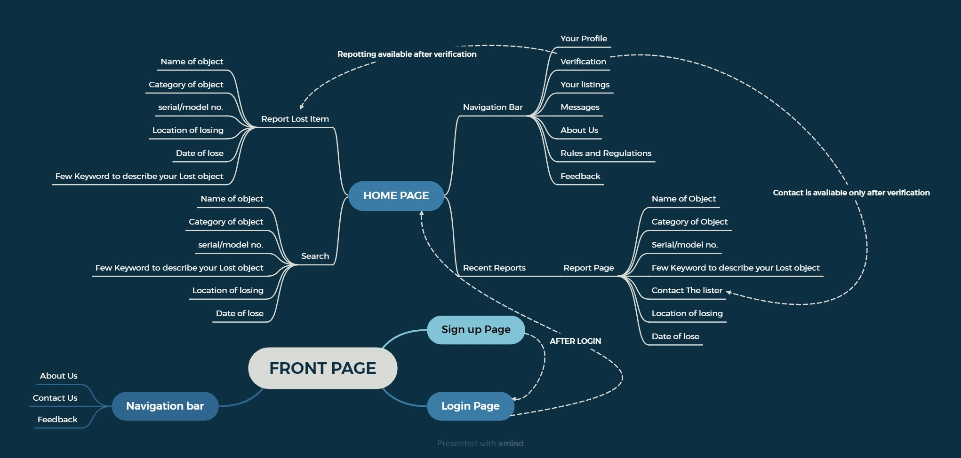
Flow diagram of project After completion

Slide 10
Technologies and Methodologies
FrontEnd: Html for Structure, CSS for style the Structure and Javascript and ReactJs for Implementing Dynamic Characters to Frontend.
Backend: Django.py for the backend will be used to tackle various problems in our website, e.g., filtering system and verification.
Database: To store all informations, such as info of the user (both the lister and the user) and data of each report.
API and others: API will be used for only functions that cannot be implemented by us alone, such as the Google Maps API for real-time tracking, etc.

Slide 11
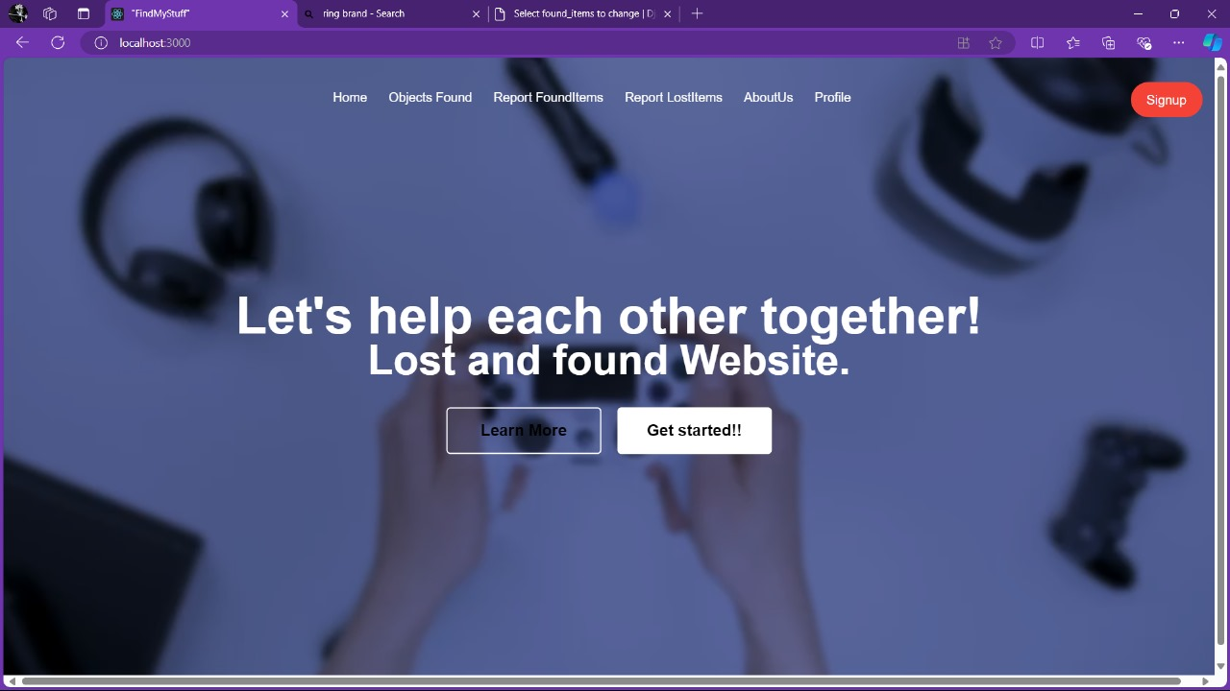
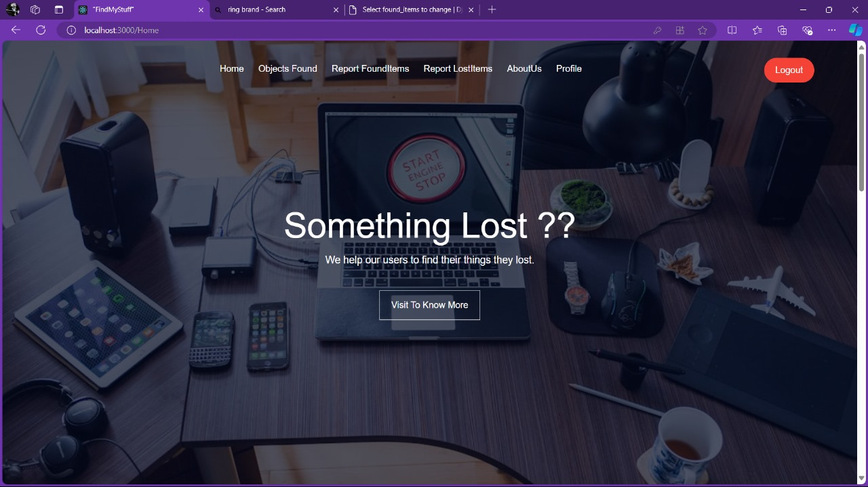
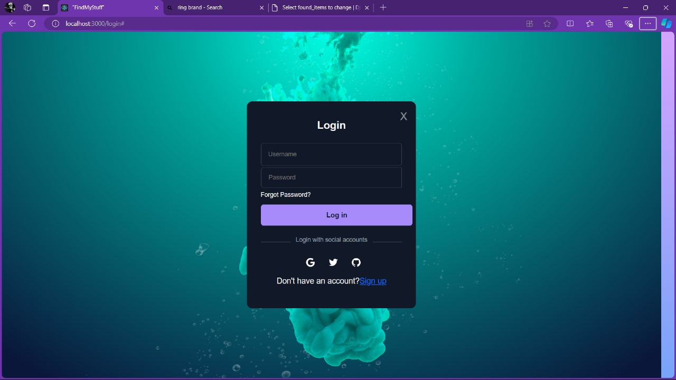
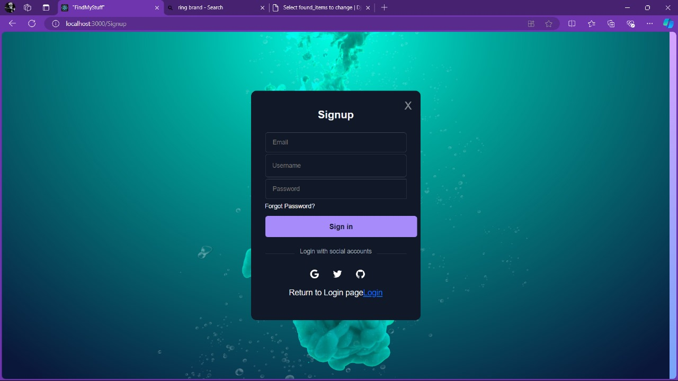
Implementation
Introduction page
Home page
Category setion
Login page
Signup page

Slide 12
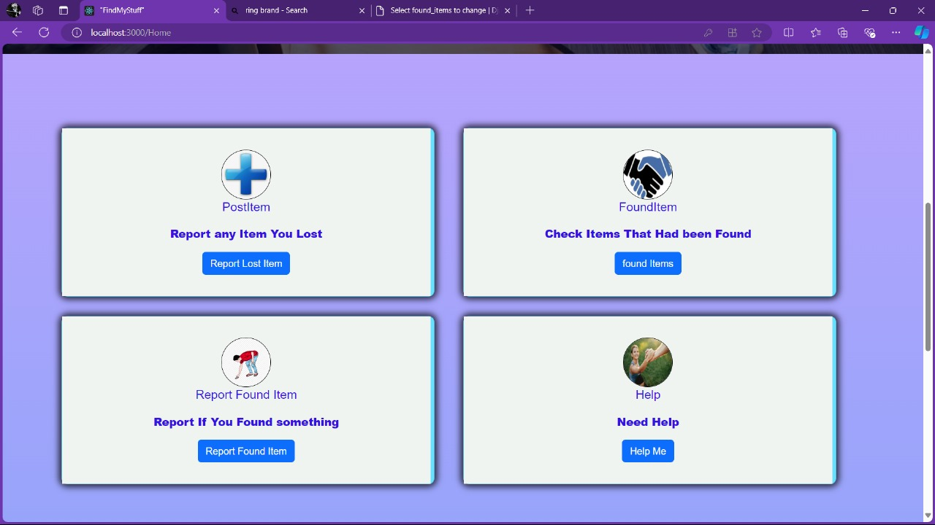
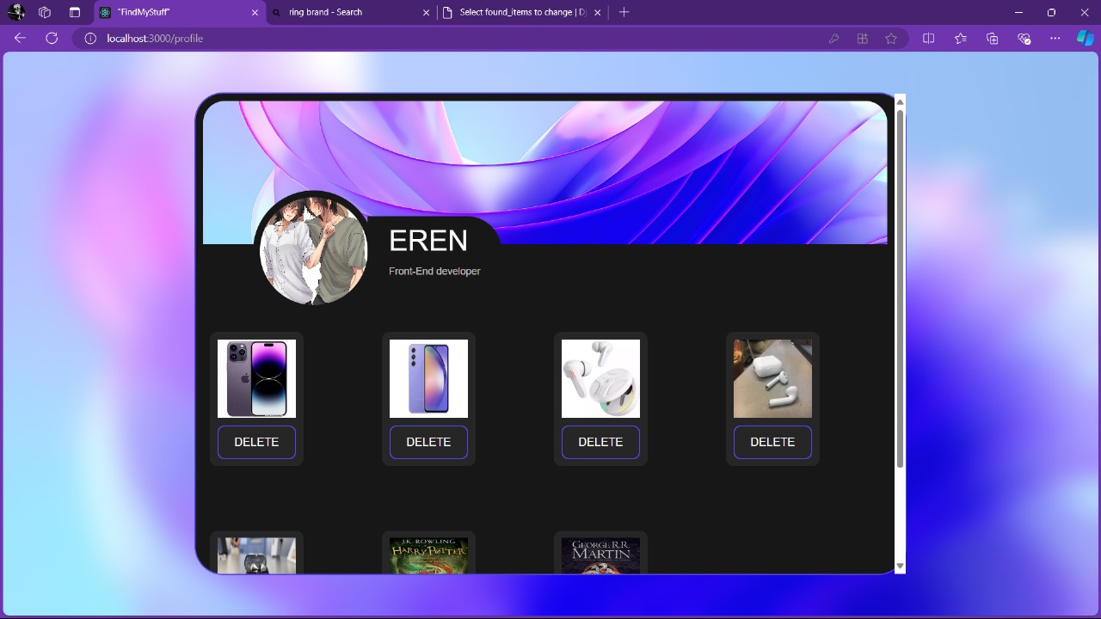
Reporting and Help page
Profile page with History of reportings

Slide 13
Conclusion
A well-designed lost and found website has the potential to make a meaningful impact by reducing the emotional and financial distress associated with lost items. By focusing on user experience, security, community engagement, and continuous improvement, the platform can become a trusted and go-to solution for individuals seeking to recover their lost belongings. Ultimately, a successful lost and found website not only reunites people with their possessions but also fosters a sense of community and mutual support, contributing positively to society as a whole.

Slide 14
References
“Investigating User Experience of Online Communities: The Influence of Community Type.”
“Privacy Preservation in Location-Based Services.”
“The location privacy protection research in location-based service.”
“Survey on performance optimization for database systems.”
“THE SHARING ECONOMY'S SUCCESS: ADVANTAGES, DRAWBACKS, AND APPLICATIONS.”
https://ieeexplore.ieee.org/document/5568118
https://www.researchgate.net/publication/262370922_Investigating_User_Experience_of_Online_Communities_The_Influence_of_Community_Type
https://www.researchgate.net/publication/323786350_Privacy_Preservation_in_Location-Based_Services
https://www.researchgate.net/publication/367154902_Survey_on_performance_optimization_for_database_systems
https://www.researchgate.net/publication/371694689_THE_SHARING_ECONOMY'S_SUCCESS_ADVANTAGES_DRAWBACKS_AND_APPLICATIONS

Slide 15
Thank You...!!

